Slide 1
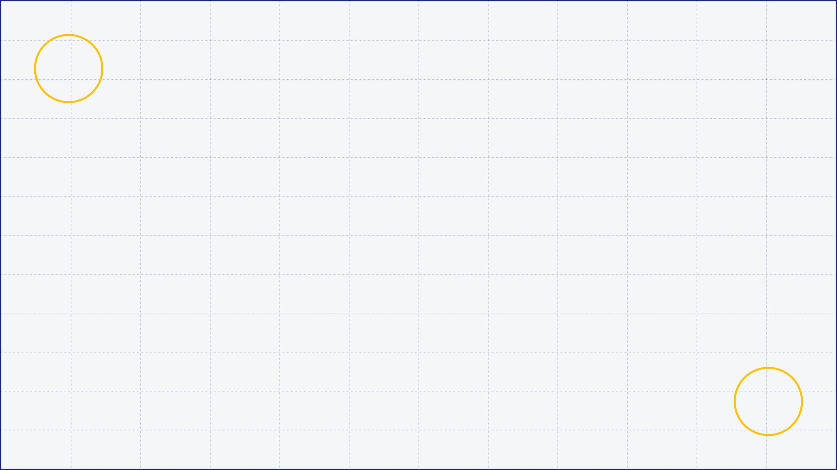
K-NEAREST NEIGHBORS (KNN) ALGORITHM
A Comprehensive Overview of Fundamentals
Miraj Deep Bhandari | June 22, 2026

Slide 2
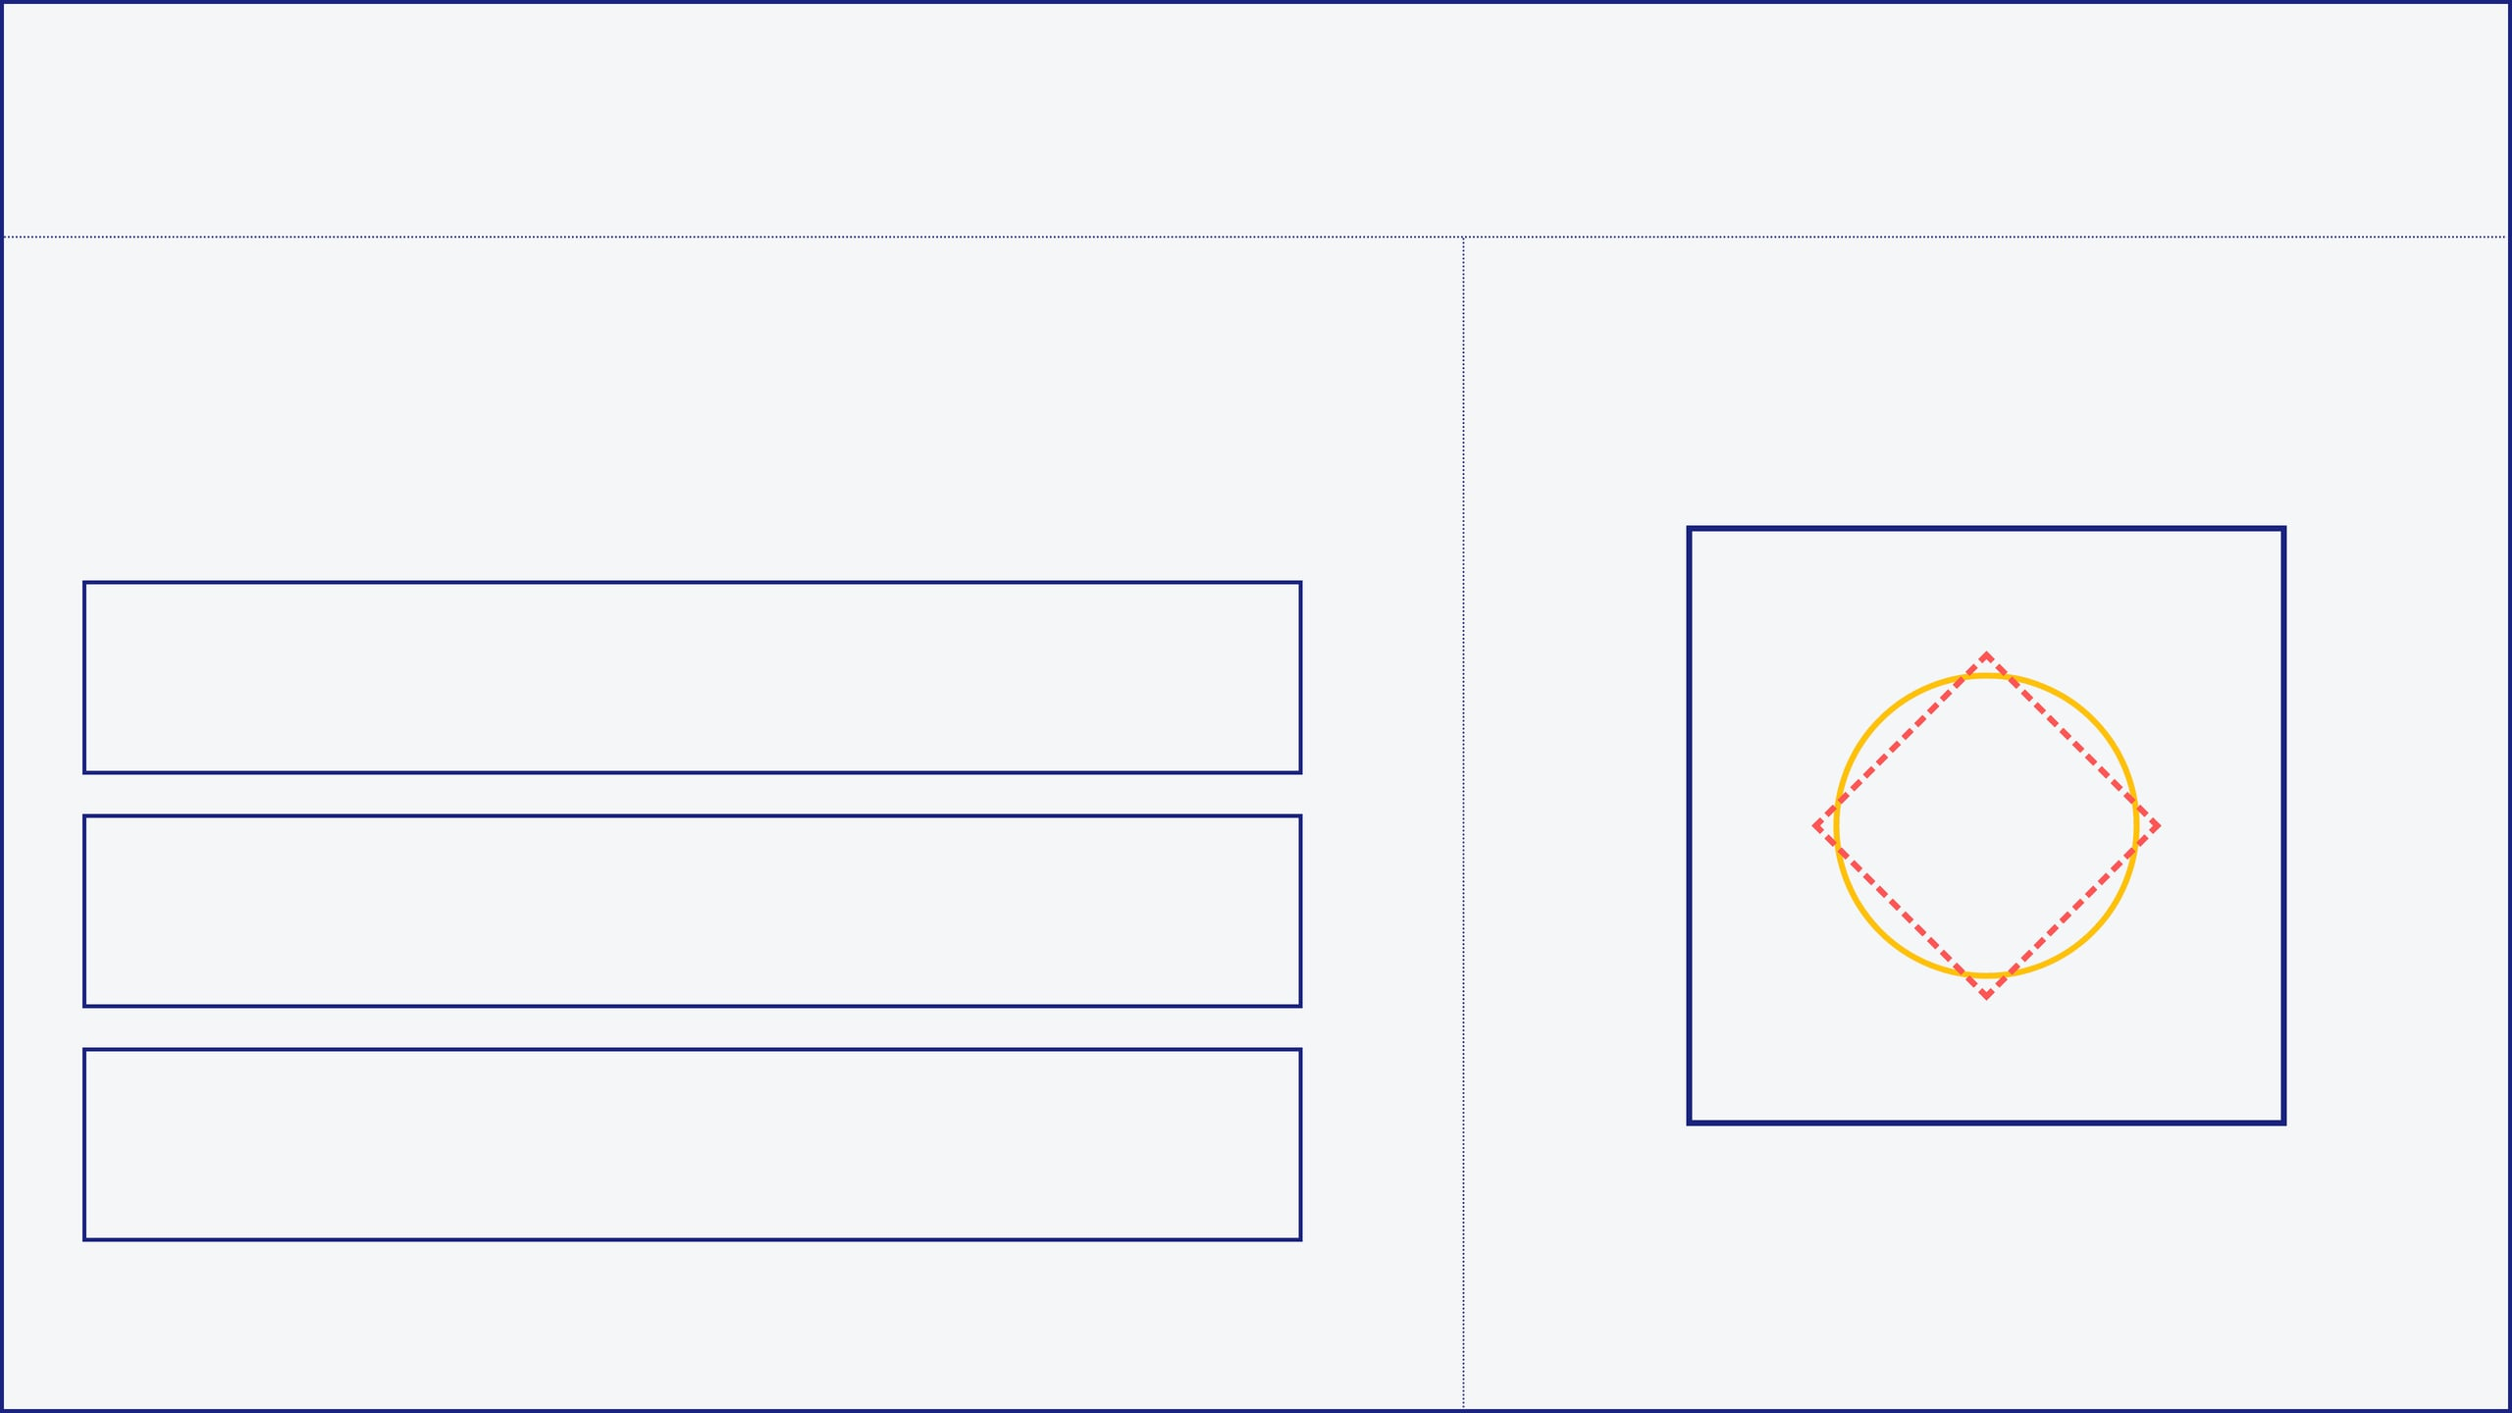
01 // WHAT IS K-NEAREST NEIGHBORS?
KNN is a versatile, non-parametric, and "lazy" learning algorithm used primarily for classification. It predicts labels based on the similarity of new instances to the existing training data.
NON-PARAMETRIC
KNN stores training data and predicts using nearby points, without training weights or a fixed model.
LAZY LEARNER
It does not learn during training; it learns when making predictions.
INSTANCE-BASED
Relies entirely on stored training instances for decision making.
VISUALIZING FEATURE SPACE

Slide 3
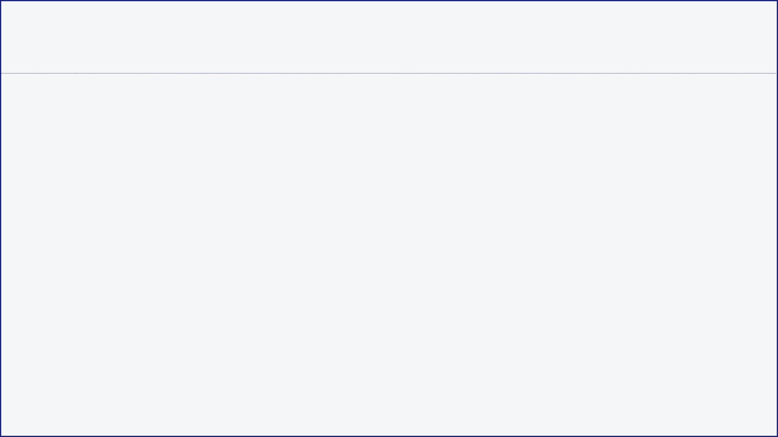
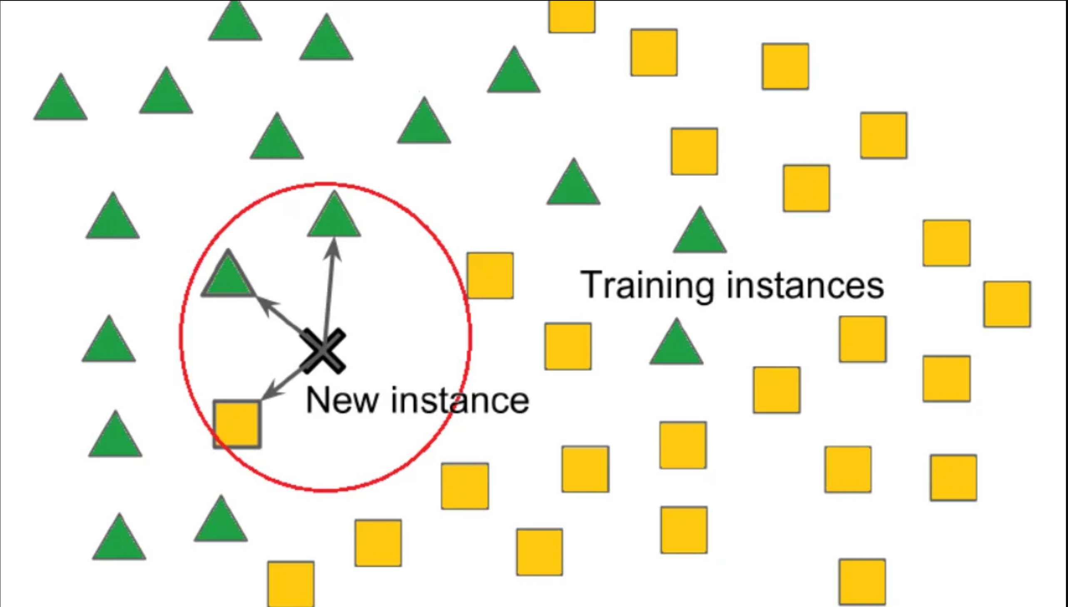
02 // THE CORE PRINCIPLE: PROXIMITY
"Similar things exist in close proximity."
KNN assumes that data points of the same category will be near each other in the feature space.

Slide 4
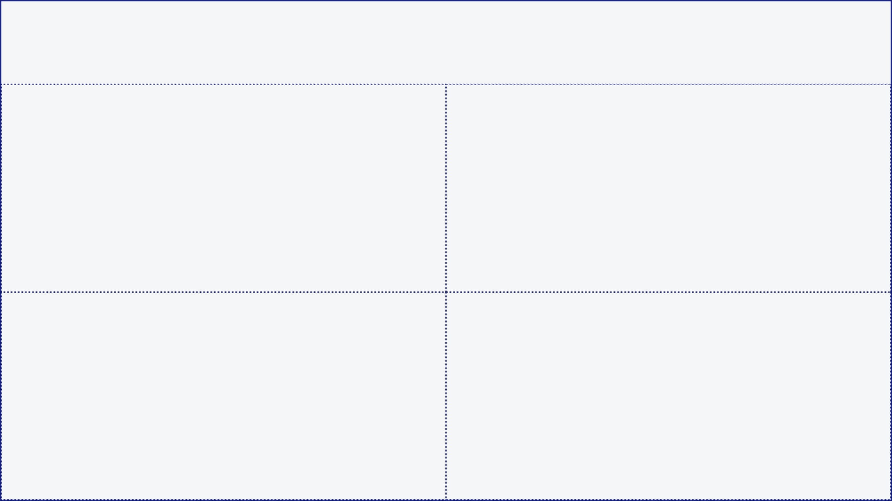




03 // ALGORITHMIC WORKFLOW
01
02
SELECT K VALUE
CALCULATE DISTANCE
Determine the number of nearest neighbors to consider. This choice significantly impacts the model's sensitivity to noise.
Compute the distance between the new query point and all training data points using metrics like Euclidean or Manhattan.
03
04
IDENTIFY NEIGHBORS
VOTE OR AVERAGE
Sort the calculated distances and select the top 'K' instances that are closest to the new data point.
Assign the class by majority vote (Classification) or calculate the mean value of neighbors (Regression).

Slide 5

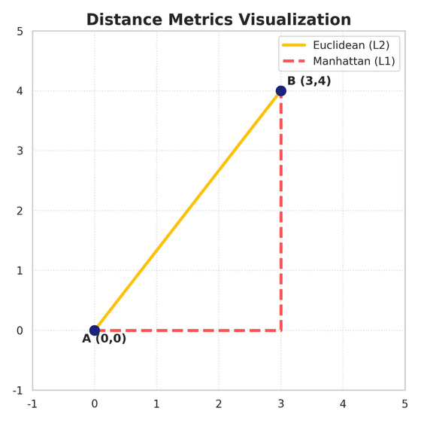
04 // MEASURING SIMILARITY: DISTANCE METRICS
EUCLIDEAN (L2)
MANHATTAN (L1)
MINKOWSKI (LP)
d = √Σ(xᵢ - yᵢ)²
d = Σ|xᵢ - yᵢ|
d = (Σ|xᵢ - yᵢ|ᵖ)¹/ᵖ
BEST FOR: Low-dimensional data where straight-line distance is meaningful.
BEST FOR: High-dimensional data or features with different scales.
GENERALIZATION: p=1 is Manhattan, p=2 is Euclidean.

Slide 6
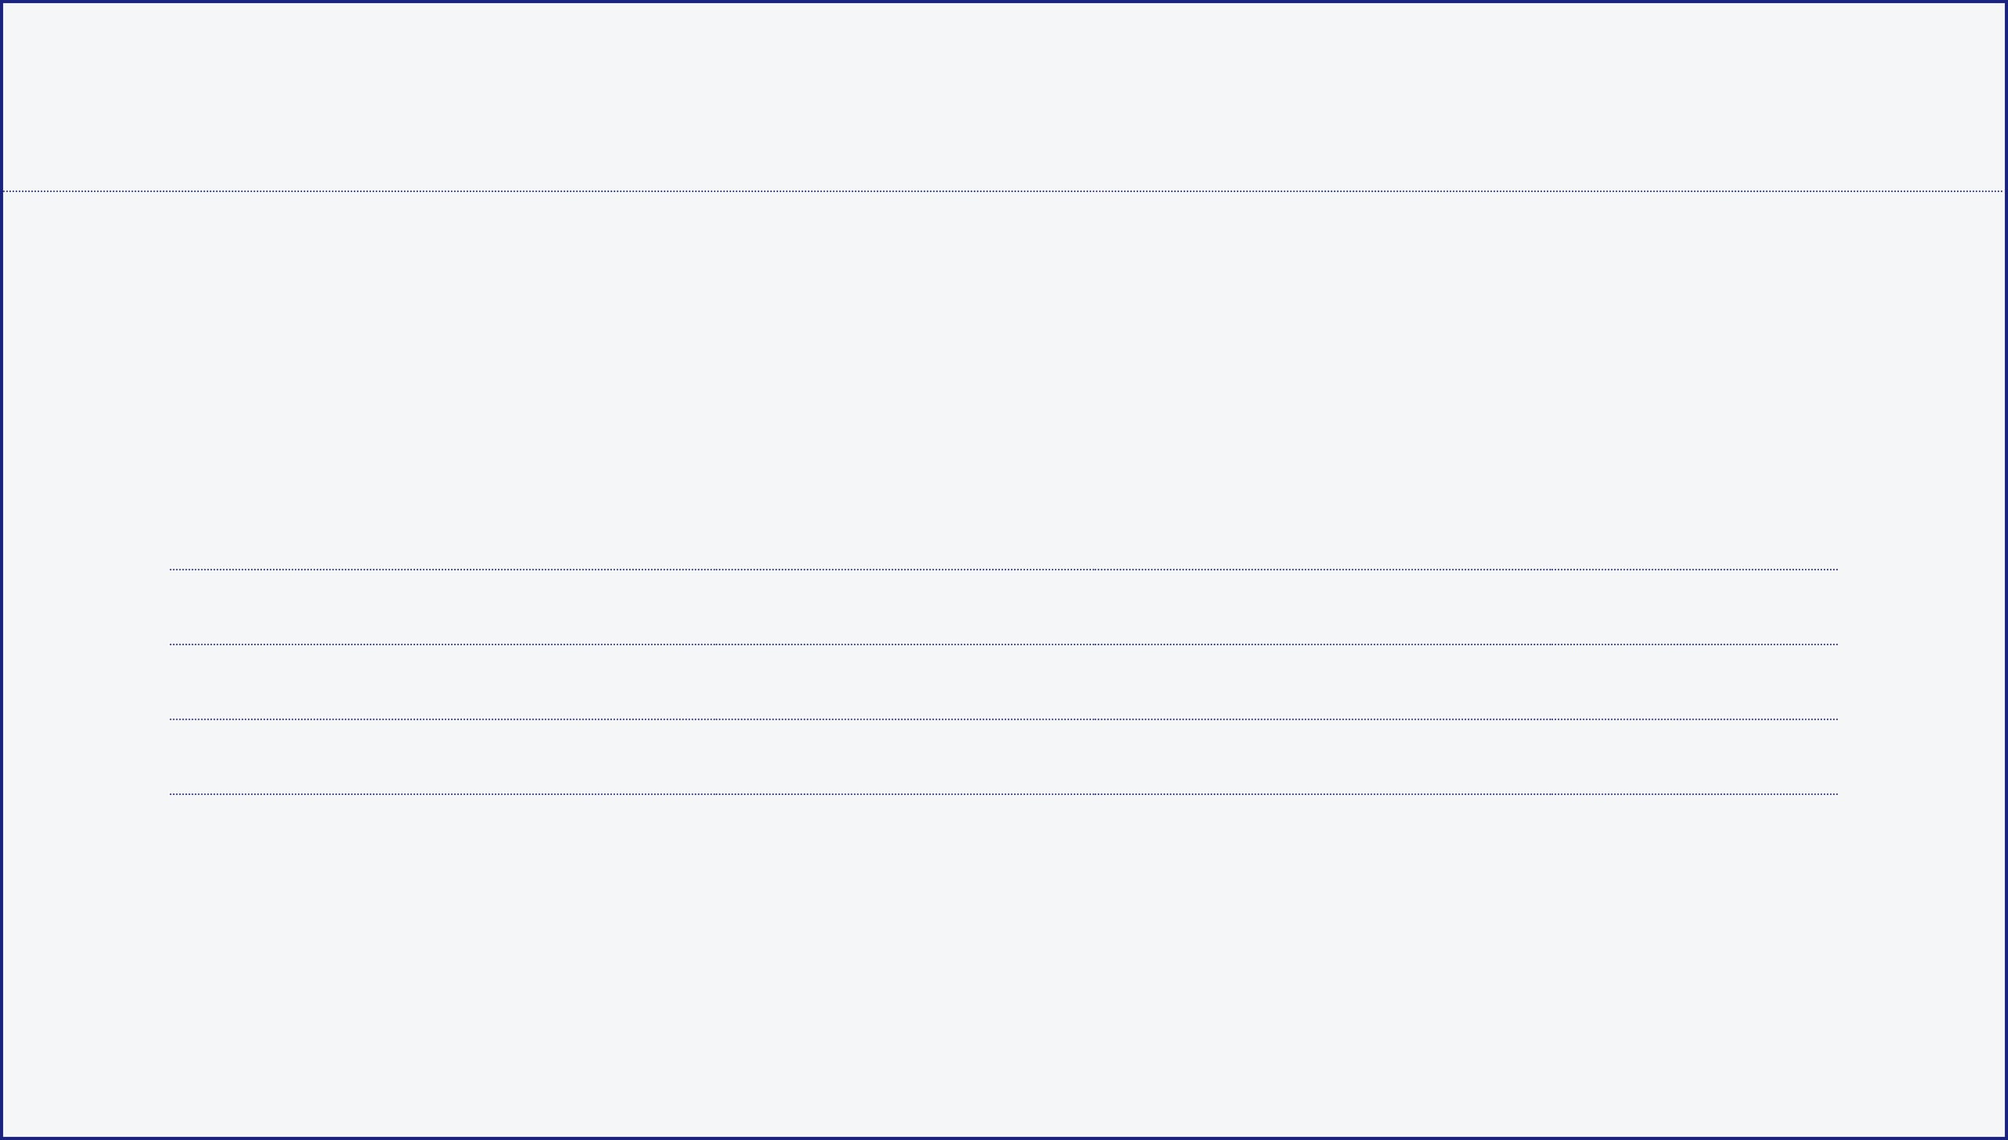
05 // CASE STUDY: MOVIE GENRE PREDICTION
We aim to predict the genre of a new movie based on its IMDb Rating and Duration using the following training dataset:
MOVIE TITLE
IMDb RATING
DURATION (MIN)
GENRE
Mission Impossible
7.8
163
ACTION
Gadar 2
6.2
170
ACTION
Rocky & Rani
6.9
168
COMEDY
OMG 2
8.0
155
COMEDY
NEW DATA POINT
BARBIE
Rating: 7.4
Duration: 114 min
Genre: ?

Slide 7
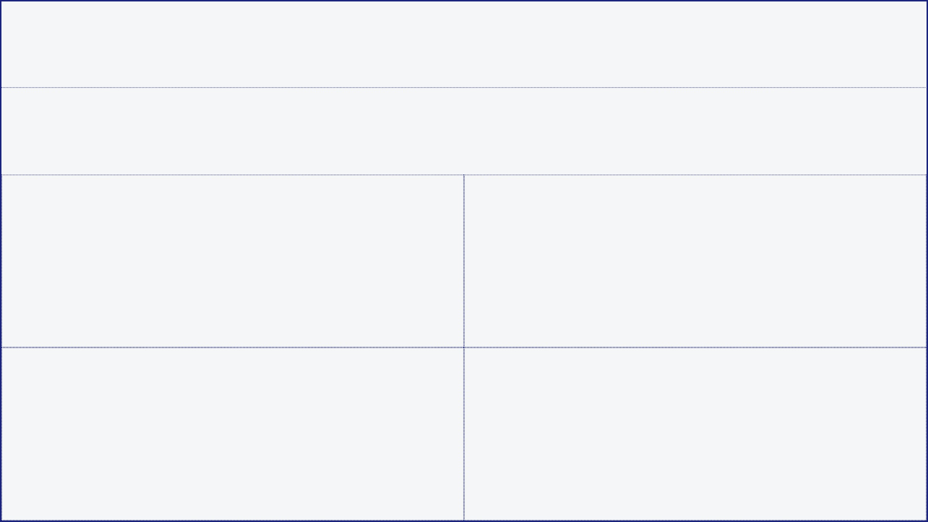
06 // STEP-BY-STEP: DISTANCE CALCULATION
Euclidean Distance: √[(Rating₁ - Rating₂)² + (Duration₁ - Duration₂)²]
Barbie (7.4, 114) vs.
Barbie (7.4, 114) vs.
MISSION IMPOSSIBLE (7.8, 163)
GADAR 2 (6.2, 170)
√[(7.8 - 7.4)² + (163 - 114)²] √[0.4² + 49²] = √[0.16 + 2401]
√[(6.2 - 7.4)² + (170 - 114)²] √[(-1.2)² + 56²] = √[1.44 + 3136]
Distance ≈ 49.00
Distance ≈ 56.02
Barbie (7.4, 114) vs.
Barbie (7.4, 114) vs.
ROCKY & RANI (6.9, 168)
OMG 2 (8.0, 155)
√[(6.9 - 7.4)² + (168 - 114)²] √[(-0.5)² + 54²] = √[0.25 + 2916]
√[(8.0 - 7.4)² + (155 - 114)²] √[0.6² + 41²] = √[0.36 + 1681]
Distance ≈ 54.01
Distance ≈ 41.00

Slide 8
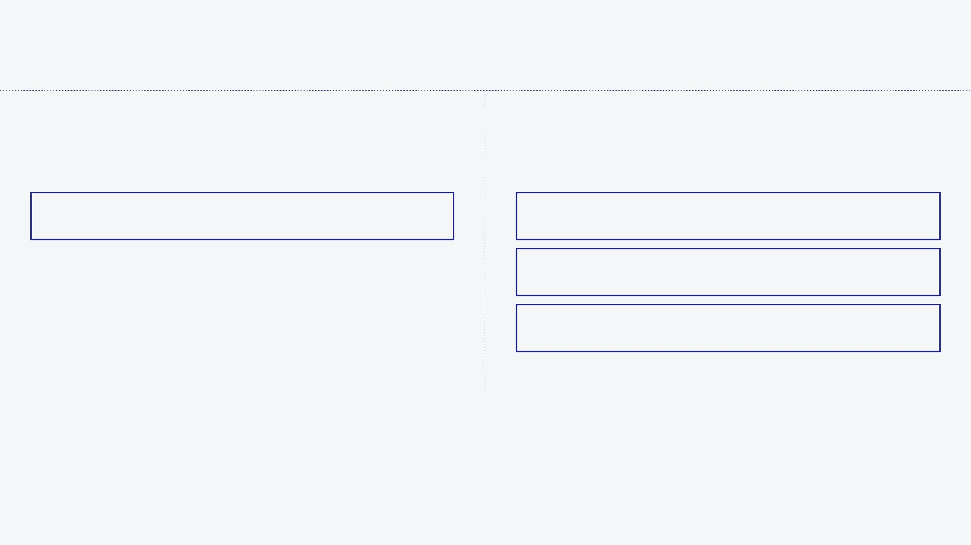
07 // FINAL PREDICTION: K=1 VS. K=3
K = 1 (NEAREST NEIGHBOR)
K = 3 (MAJORITY VOTE)
Assigns the class of the single closest data point.
Assigns the class based on the most frequent label among 3 neighbors.
1. OMG 2 (Dist: 41.0)
COMEDY
1. OMG 2 (Dist: 41.0)
COMEDY
Prediction: COMEDY
2. Mission Impossible (Dist: 49.0)
ACTION
3. Rocky & Rani (Dist: 54.0)
COMEDY
Vote: 2 Comedy vs 1 Action
BARBIE = COMEDY
Consensus reached across both K values based on feature proximity.

Slide 9
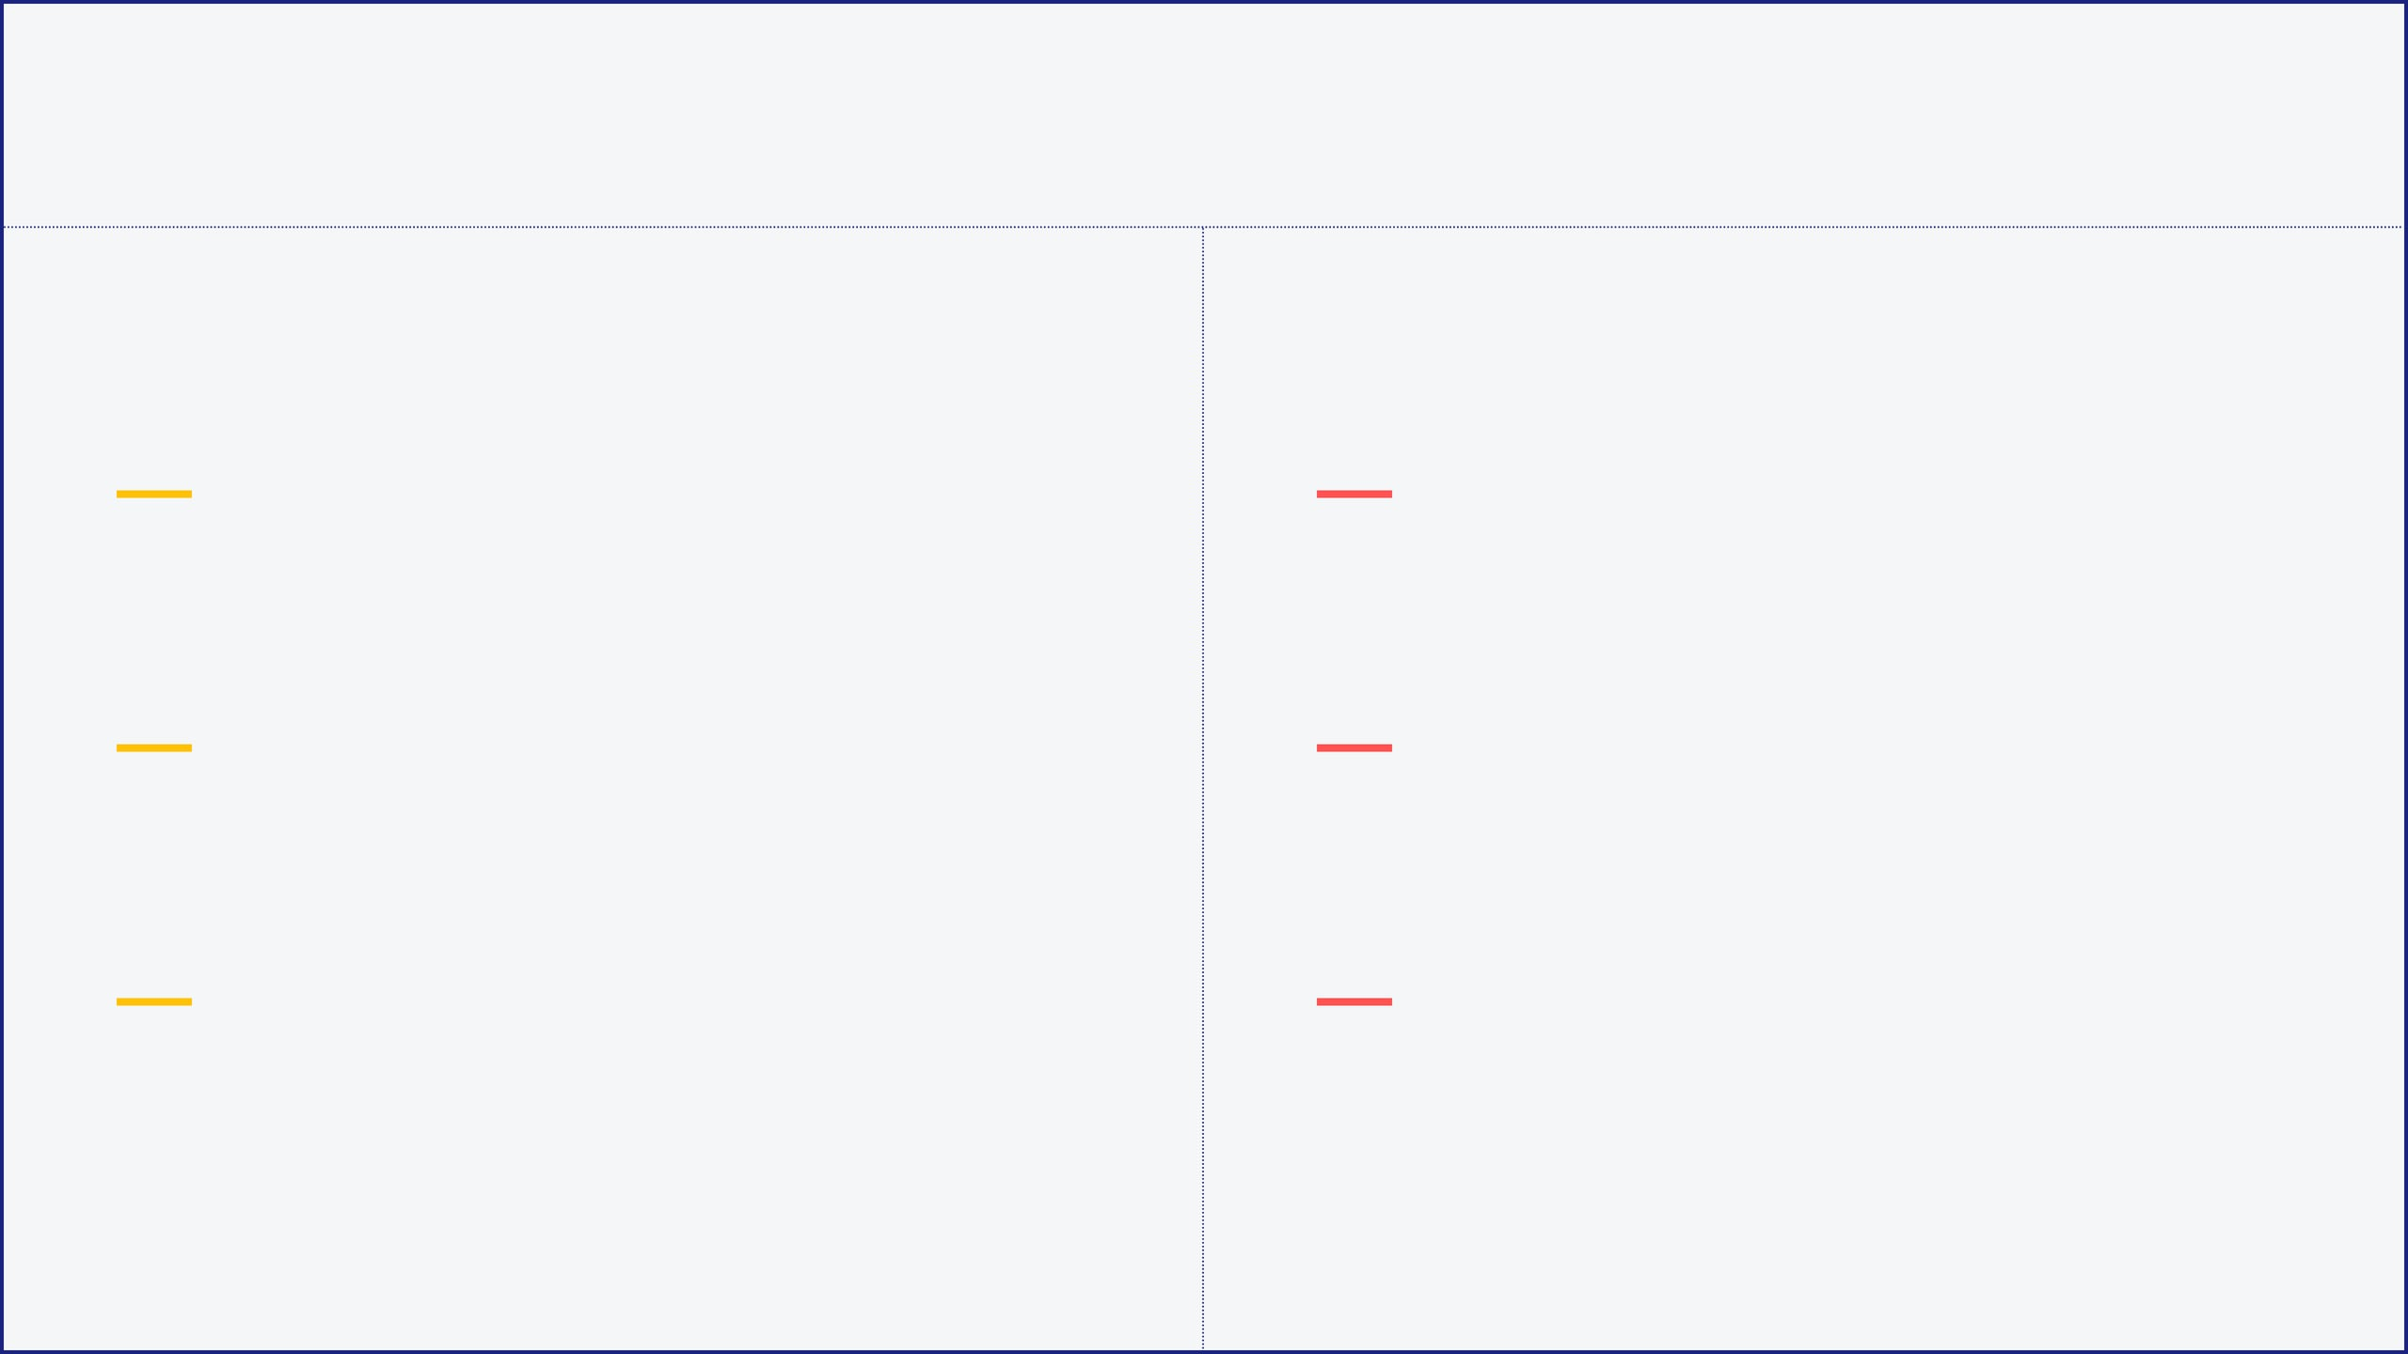


08 // ADVANTAGES AND DISADVANTAGES
ADVANTAGES
DISADVANTAGES
SIMPLICITY
COMPUTATIONAL COST
Extremely easy to understand and implement. Requires minimal hyperparameter tuning beyond 'K'.
Slow for large datasets as it calculates distances to every training point for each prediction.
NO TRAINING PHASE
MEMORY INTENSIVE
As a "Lazy Learner," it doesn't require a training period, making it instantly ready for new data.
Requires storing the entire training dataset in memory, which can be prohibitive for big data.
NON-PARAMETRIC
CURSE OF DIMENSIONALITY
Makes no assumptions about data distribution, allowing it to handle complex decision boundaries.
Performance degrades significantly as the number of features increases (high-dimensional space).

Slide 10




9 // REAL-WORLD APPLICATIONS
RECOMMENDATION SYSTEMS
IMAGE RECOGNITION
Finding similar users or items based on preferences. Used by platforms like Netflix or Amazon to suggest content.
Classifying images or identifying objects by comparing pixel intensity patterns to a labeled database.
COLLABORATIVE FILTERING
COMPUTER VISION
ANOMALY DETECTION
HEALTHCARE
Identifying unusual data points that are far from any cluster of neighbors, useful in credit card fraud detection.
Predicting patient outcomes or disease risk by finding patients with similar clinical profiles and histories.
SECURITY & FINANCE
CLINICAL DIAGNOSTICS

Slide 11

10 // SUMMARY AND KEY TAKEAWAYS
KNN is a fundamental "Lazy Learning" algorithm that leverages the power of proximity to make intuitive and effective predictions.
SIMPLICITY & FLEXIBILITY
CRITICAL PARAMETERS
OPERATIONAL COSTS
Easy to implement and understand. Being non-parametric, it adapts to various data distributions without prior assumptions.
The choice of 'K' and the distance metric (Euclidean vs. Manhattan) are the primary levers for tuning model performance.
While simple, KNN is memory-intensive and computationally expensive for large datasets, requiring careful feature scaling.

